Slide 1
Se - 216 Group 1 Servicify
Developed By:
Buğra Yurtsever 20210601068
Barış Can Ceylan 20190601053
Alperen Demirezen 20210601021
Ege Sezak 20220601059

Slide 2
OVERVIEW
1. Introduction
2. Objective
3. Software Requirements
4. Software Process
5. Software Tools
6. Software Measurements
7. Project Risks
8. Project Stakeholders
9. Project Needs
10. Project Schedule
11. User Interfaces
12. Conclusion

Slide 3
1. INTRODUCTION
What is Servicify?
Why Servicify?
Benefits Of Servicify

Slide 4
2. Objective
Our Aim is to provide a high quality experience for the customers that are looking for different services within the same application. This way we are making it easy for them to access them all in the “Servicify” app.

Slide 5
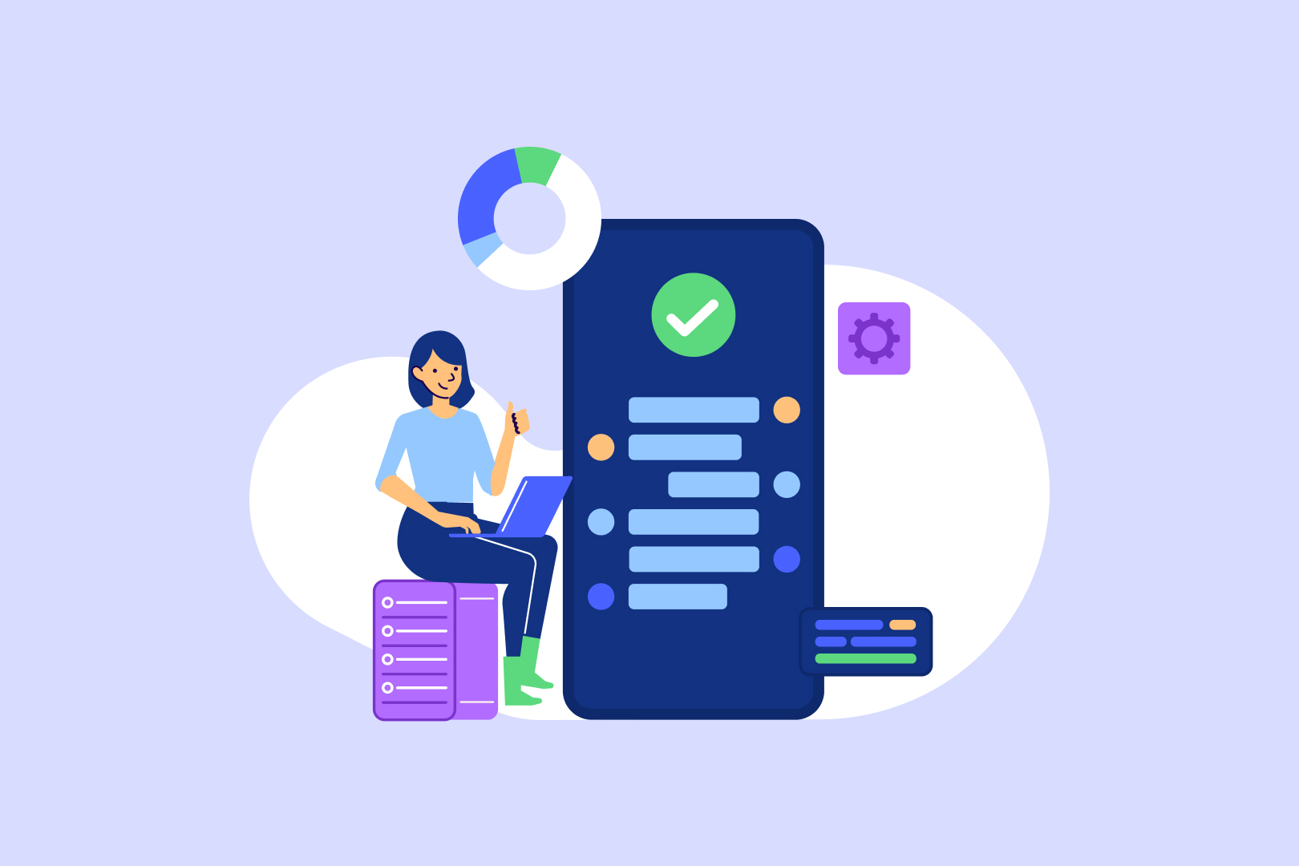
3. Software Requirements
1- FUNCTIONAL REQUIREMENTS
2- NON-FUNCTIONAL REQUIREMENTS

Slide 6
3.1 Functional Requirements
Users should be able to create accounts and log in securely.
Users should be able to search services near them using location services.
Vendors should be able to list their products or services for sale.
Users should be able to add items to their shopping carts and proceed to checkout.
Restaurants should be able to create/modify menus.
The application should provide analytics and reporting tools for businesses to track performance, user behavior, and overall system usage.

Slide 7
3.1 Functional Requirements
Users should be able to view the status of their orders in real-time.
Vendors should have access to tools for managing orders, including order fulfillment and tracking.
Users should be able to leave reviews and ratings for products/services they have purchased.
Vendors should be able to respond to reviews and address customer feedback.
The application should support multiple languages and currencies to cater to a global user base.

Slide 8
3.1 Functional Requirements
Vendors should be able to respond to reviews and address customer feedback.
The application should support multiple languages and currencies to cater to a global user base.
Multiple payment methods should be supported, including credit/debit cards, digital wallets, and cash on delivery.
System should be able to recommend services based on previous user purchases.
Users should be able to search for specific services or products and apply filters to narrow down their choices.

Slide 9
3.2 Non-Functional Requirements
The application must implement robust security measures, including encryption, secure authentication, and protection against common vulnerabilities.
In case of an unexpected crash, the system should not lose vital information.
Loading times for pages and images should be minimal and intuitive to ensure a seamless user experience.
The system should be able to handle increasing numbers of concurrent users during peak hours without a significant decrease in performance.

Slide 10
3.2 Non-Functional Requirements
The application should be compatible with a wide range of devices and screen sizes, including smartphones, tablets, and desktop computers.
Modular design principles should be followed to allow for easy addition of new features and modifications
The application should comply with relevant regulations and standards, ensuring legal and ethical operation.
Regular data backups should be performed, and the system should have a reliable data recovery mechanism in case of data loss.

Slide 11
4.0 Software Process
4.1 Necessary Needs From The Organizational Process
4.2 Software Process Model

Slide 12
4.1 Necessary Needs From The Organizational Process
1 | Having daily meetings should be held to facilitate group discussion.
2 | The process must be easily adaptable to changing requirements. There will always be changes during the process, it will be nice to make it adaptable.
3 | It is crucial to discover an error in the process immediately when it occurs. A small error might lead to having a bigger error if not fixed in time.
4 | The project should be divided into smaller tasks to aid in development. Simpler the project is, the faster the process will be.
5 | Previous increments should be considered to find potential problems. It is likely to see the same problems in the future so previous increments can help us.
6 | Collaboration and accountability should be encouraged among team members. It is important to pay attention to the team's motivation.
7 | Increments of the product should incorporate customer feedback throughout the development process.
8 | Fixing mistakes should cost minimal time and cost. If fixing problems takes too much time and money, it will jeopardize the future of the project.

Slide 13
4.2 Software Process Model
SCRUM
The Scrum software development process is an iterative and incremental agile framework designed to deliver high-value software in a flexible and adaptive manner. Scrum fosters collaboration, transparency, and continuous improvement within cross-functional teams. Since scrum is a framework, hence it can be modified. This allows the team to create a productive environment. There are several roles such as product owner, scrum master and developers.

Slide 14
4.2 Software Process Model
Our project, unifying several services under one roof is quite a large undertaking. This makes it easy to fail in the event that the team loses focus during development. With scrum, we can divide the difficult tasks of this project into smaller pieces making the team motivated to finish the project efficiently.
The Sprints:
Login/sign up system for service providers. (25 days)
Login/sign up system for users. (10 days)
Database design. (20 days)
Framework for general service providers/markets. (36 days)
Framework for clothing stores. (51 days)
Framework for restaurants. (56 days)
Implementing the user rating system. (20 days)
Payment system. (20 days)
General UI design. (20 days)
Implementing security features. (10 days)

Slide 15
4.2 Software Process Model
REASONS TO CHOOSE THIS MODEL:
Scrum's core principles enable the team and stakeholders to constantly see the status of the work. This helps the team make better decisions and reduce risks. In startups like ours, it is imperative that we do not make any mistakes. Since the smallest mistake can bankrupt us. Sprints are essential for scrum. Each Sprint aims to increase value. This enables continuous improvement of the product and faster delivery to customers and stakeholders. E-commerce is a competitive market and it is important to follow new trends and adapt to the changing environment. Scrum provides the ability to adapt quickly to changing requirements making it ideal for our use case. With feedback from the stakeholders , the team constantly learns and improves while delivering the product. Scrum encourages the creation of small, cross-functional teams. Such teams often work more efficiently and produce more creative solutions, and the absence of multi-layered hierarchies alleviate management overhead which speeds up the development . To conclude, scrum is a versatile framework that aids our team to make better decisions and decrease the risk of fatal mistakes, all the while making our project more flexible to changing requirements of the industry. These advantages show that Scrum provides more effective business process management for our organization. Scrum offers excellent solutions to achieve our goals, especially in complex and rapidly changing projects like ours.

Slide 16
5.0 Software Tools
5.1 Project Tasks Which Require Software Tool Support
5.2 User Interface
5.3 Data Management and Database Infrastructure
5.4 Customer Support Tools
5.5 Financial Management

Slide 17
5.1 Project Tasks Which Require Software Tool Support
User Interface
Data Management and Database Infrastructure
Customer Support Tool
Financial Management Tool

Slide 18
5.2 User Interface
Kotlin/Jetpack Compose: Android recommends Jetpack Compose as a contemporary toolset for creating native user interfaces. It streamlines and expedites Android UI development. Develop your project more quickly with less code, stronger tools, and user-friendly Kotlin APIs.
Swift/SwiftUI: SwiftUI helps you build great-looking apps across all Apple platforms with the power of Swift — and surprisingly little code. You can bring even better experiences to everyone, on any Apple device, using just one set of tools and APIs.
Javascript/React Native: The finest aspects of native programming are combined with React, the top JavaScript user interface toolkit, to create React Native.

Slide 19
5.3 Data Management and Database Infrastructure
Tool Cost/Training/Functionality Data
Tool | MongoDB | MySQL | PostgreSQL | Amazon DynamoDB
Cost | 191.406$ | 29.327,64$ | 335.373$ | 54.210,24$
Training Days | 7 | 7 | 30 | 15
Functionality | 10 | 1 | 3 | 7
Normalized Cost/Training/Functionality Data
Tool | MongoDB | MySQL | PostgreSQL | Amazon DynamoDB
Cost | 57.1 | 8.7 | 100.0 | 16,2
Training Days | 23.3 | 23.3 | 100.0 | 50.0
Functionality | 100 | 10 | 30 | 70

Slide 20
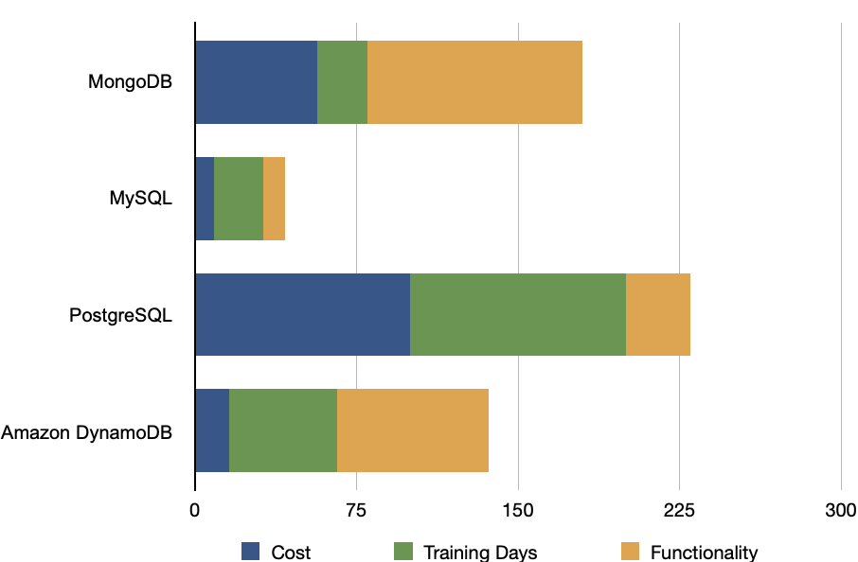
5.3 Data Management and Database Infrastructure
Normalized Tool Graph

Slide 21
5.4 Customer Support Tools
Tool Cost/Training/Functionality Data
Tool | Zendesk | Freshdesk | Intercom
Cost | 1400$ | 1000$ | 1700$
Training Days | 7 | 7 | 7
Functionality | 8 | 6 | 10
Normalized Cost/Training/Functionality Data
Tool | Zendesk | Freshdesk | Intercom
Cost | 82.3 | 58.8 | 100.0
Training Days | 100.0 | 100.0 | 100.0
Functionality | 80.0 | 60.0 | 100.0

Slide 22
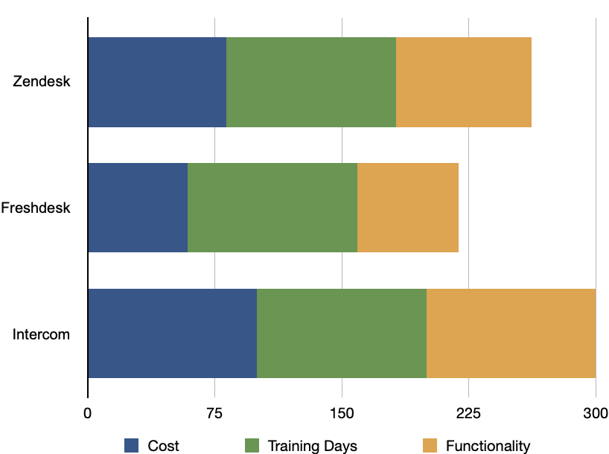
5.4 Customer Support Tools
Normalized Tool Graph

Slide 23
5.5 Financial Management
Tool Cost/Training/Functionality Data
Tool | QuickBooks | Xero | Sage Intacct | NetSuite
Cost | 1000$ | 1500$ | 3600$ | 12.000$
Training Days | 21 | 15 | 21 | 30
Functionality | 4 | 7 | 5 | 10
Normalized Cost/Training/Functionality Data
Tool | QuickBooks | Xero | Sage Intacct | NetSuite
Cost | 8.3 | 12.5 | 30.0 | 100.0
Training Days | 70.0 | 50.0 | 70.0 | 100.0
Functionality | 40.0 | 70.0 | 50.0 | 100.0

Slide 24
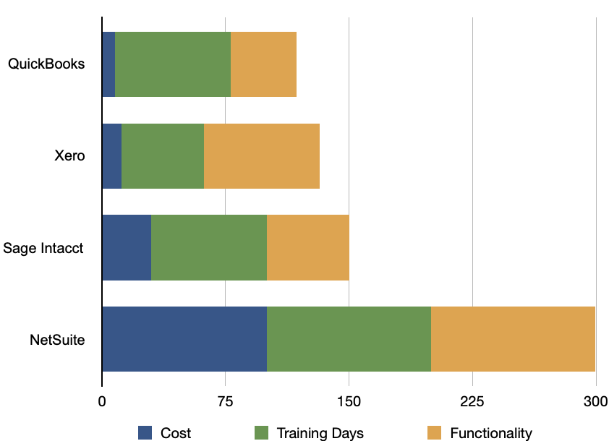
5.5 Financial Management
Normalized Tool Graph

Slide 25
6.0 Software Measurements
6.1 Questions to Identify Measurements
6.2 Identified Measurements
6.3 Measurement Types

Slide 26
6.1 Questions to Identify Measurements
What did the team produce? (sprints)
How much effort did this project require?
How much effort went to testing?
How many times has the code been tested?
How many commits have been done?
What is the defect density in the code?

Slide 27
6.2 Identified Measurements
Number of hours spent working.
Number of times code committed.
Number of sprints finished.
Number of test cases written.
Number of times that tests have failed.

Slide 28
6.3 Measurement Types
Measurement Type | Description | Example Measurements
Hours spent working | This measurement measures how much time has the team spent working on the project. | At the end of each week, a monitoring program tracks the number of hours spent working by a developer.
Number of commits | This measurement measures how many times the code has been committed by a team member and the commit is rated by a senior developer by 0-10 depending on the features of the commit. Every member has to meet a weekly quota. | The amount of times a member committed code daily*rating of the commit.
Number of tests | This measurement measures how many test cases the code has to pass before the code can be committed. | A development team runs unit tests regularly before every commit and the size of the test cases increases as the code base develops.
Error | This measurement measures errors that occur during the testing phase of the software and represent undesirable behavior of software. | In the event that a developer gets more errors than normal or seen struggling with development of a feature the workload can be redistributed depending on the situation.
Defect Density | The number of faulty components or faulty lines of code in a product. The decrease of this value may indicate the experience of the team. | During a sprint, 1000 lines of code are written and 10 of them are buggy in subsequent testing. In this case, the error density is 1%.

Slide 29
7.0 Project Risks
7.1 Likelihood & Impact Rank
7.2 Combined Rank

Slide 30
7.1 Likelihood & Impact Rank
1 | Communication Issues
2 | Integration Challenges
3 | Software Problems
4 | Inadequate Planning
5 | Infrastructure Problems
6 | Cyber Attack
7 | Legal Issues
8 | Staffing Shortages
9 | Company Leaks
1 | Software Problems
2 | Legal Issues
3 | Company Leaks
4 | Infrastructure Problems
5 | Integration Challenges
6 | Cyber Attack
7 | Inadequate Planning
8 | Staffing Shortages
9 | Communication Issues

Slide 31
7.2 Combined Rank
1 | Software Problems
2 | Integration Challenges
3 | Infrastructure Problems
4 | Legal Issues
5 | Communication Issues
6 | Inadequate Planning
7 | Cyber Attack
8 | Company Leaks
9 | Staffing Shortages

Slide 32
8.0 Project Stakeholders

Slide 33
Project Stakeholders
1 | Project Owner:The project owner is the highest authority, responsible for overseeing the entire project and making final decisions.
2 | Developers:Developers are the individuals responsible for creating and maintaining the software.
3 | Managers: Managers oversee the project's progress, manage team dynamics, and ensure that project goals are met.
4 | Restaurants & Other Vendors: These stakeholders use the software to sell their goods and services.
5 | Users: Users interact with the software, and their experience is paramount.
6 | Investors: Investors provide the necessary capital for the project.
7 | Support Team: The support team addresses user issues and serves as the bridge between users and developers.
8 | Couriers: Couriers deliver services to customers and are paid based on their deliveries.

Slide 34
9.0 Project Needs
9.1 Software Needs
9.2 Hardware Needs
9.3 Support Needs

Slide 35
9.1 Software Needs
# | SOFTWARE NEEDS | DESCRIPTION
1 | Docker | Docker is a software framework that streamlines the process of updating and deploying software on a server.
2 | Kubernetes | This software manages server workloads and makes load balancing easier to manage.
3 | Ansible | Ansible is a computer configuration automation and management tool. This makes maintaining multiple servers easier by automating the process.
# | Software Needs | DESCRIPTION
4 | IDE | We will use vs code, as its support for plugins enable it to have support for a wide range of programming languages.
5 | Katalon | Katalon is a test management tool that helps to streamline software testing processes.

Slide 36
9.1 Software Needs
6 | Slack | Slack is a cloud based professional communication and collaboration tool that will be used to facilitate communication between members.
7 | Microsoft Project | Microsoft Project is a time table creation and management tool. This will enable the team to plan and track their schedule.
8 | Git | Git is a version control and source management software that we can use to track the changes that are done to the codebase.

Slide 37
9.2 Hardware Needs
# | HARDWARE NEEDS | DESCRIPTION
1 | Developer workstations | These general purpose computers will allow developers of the software to write code and test the software
2 | Host mobile devices | These devices will allow users to interact with our program. These devices include: mobile devices, tablets, and etc.
3 | Server Hardware (AWS) | These devices can be around the world communicating with each other and other mobile devices. These computers are the most costly and important part of our hardware needs as most of the processing power required by our software will be handled by these machines. We will use Amazon as our service provider

Slide 38
9.3 Support Needs
# | SUPPORT NEEDS | DESCRIPTION
1 | Customer support (Intercom) | Making customers feel safe using our app is essential. We have chosen Intercom, a customer messaging platform that provides live chat, to fill this need.
2 | Cloud Hardware Providers (AWS) | It is more cost effective to rely on cloud hardware providers than to rent space in a data center and populating it with our own hardware. Thus it is important to be able to get support from the cloud hardware providers.
# | SUPPORT NEEDS | DESCRIPTION
3 | Financial support | Having good financial advisors is important for this project.
4 | Legal support | Having a good legal team is essential for the longevity of this project as there can be legal constraints that need to be considered.
5 | User support (User feedback) | Getting feedback regarding app usage and opinion from users are crucial as their satisfaction will make this project successful.

Slide 39
10. Project Schedule

Slide 40
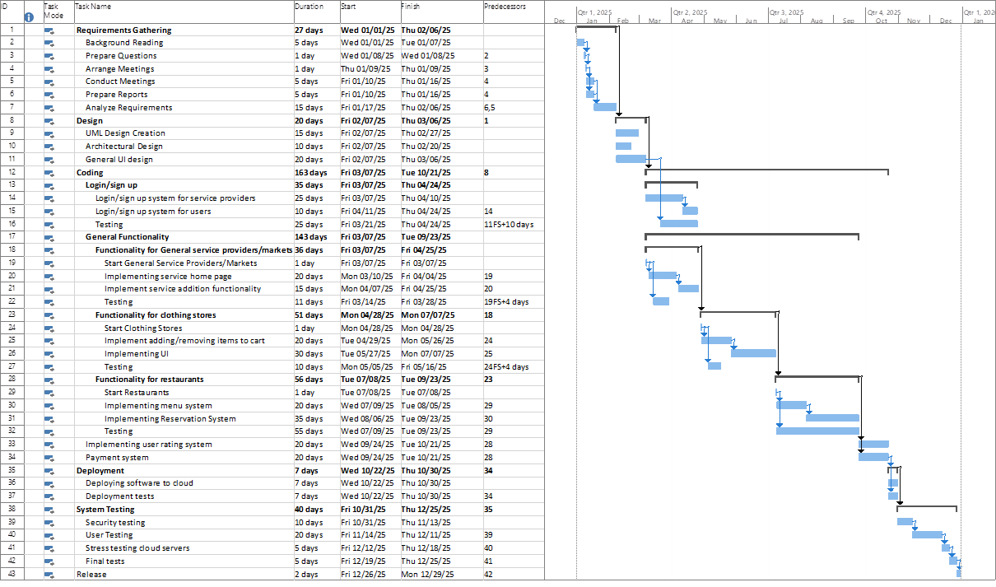
10. Project Schedule

Slide 41
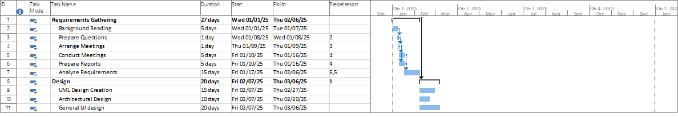
10. Project Schedule

Slide 42
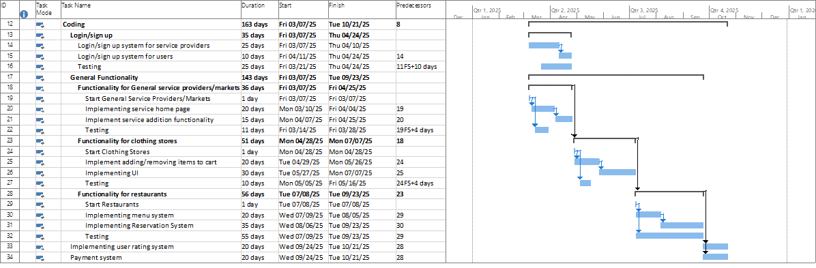
10. Project Schedule

Slide 43
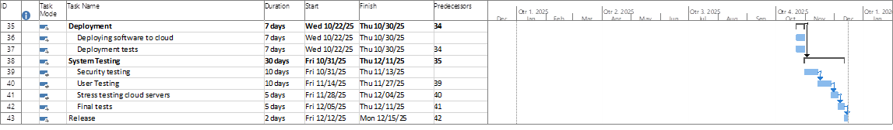
10. Project Schedule

Slide 44
Thank you for listening

